Slide 1
Sprint-1 Project presentation
On E-Commerce Case Study
Submitted By-
Pragya Rathi

Slide 2
Presentation Flow
Introduction
Existing Work
Purpose
Overall Architecture Diagram

Slide 3
Requirements
VISUAL STUDIO VERSION(USEING) 2022
ANGULAR JS FRONTEND USE
HTMS/CSS – MAKING WEBPAGE PRESENTABLE
MS-SQL-DATABASE DATABASE REQUIREMENT

Slide 4
Introduction
Below are the objectives that shall be fulfilled post the
execution of this project:
Admin • Access to Admin home page • Edit Profile • Has option of Verified the Customer. • Can view the request status • Admin can Add or remove the Customer and view the customer list. • Admin can also reject the request of organizer at certain conditions. •Admin can hide or delete the feedback of the customer.

Slide 5
Introduction & Existing Work
Customer • Visit the web application •View the Product • Create new Account • Access to Customer home page • Edit Profile • Has option to Buy Product • Can view the request status • • Customer Can add the personal details. • Customer can do COD payment method • Customer can give the feedback.

Slide 6
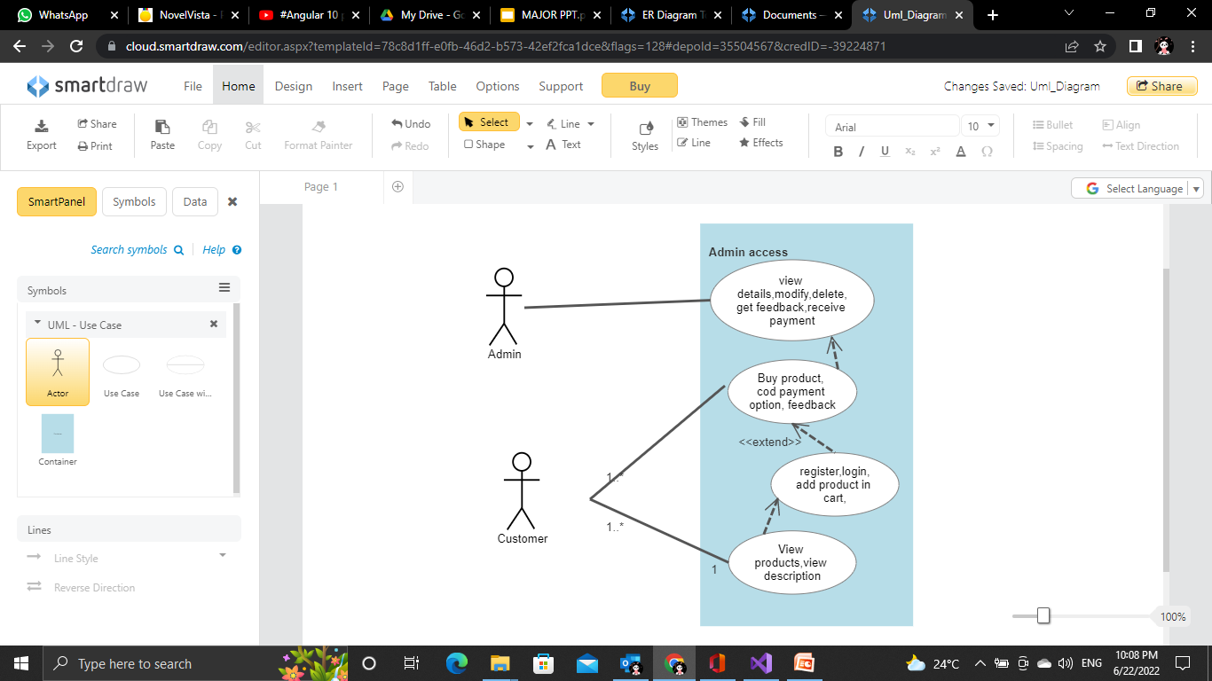
Overall Architecture Diagram UML DIAGRAM

Slide 7
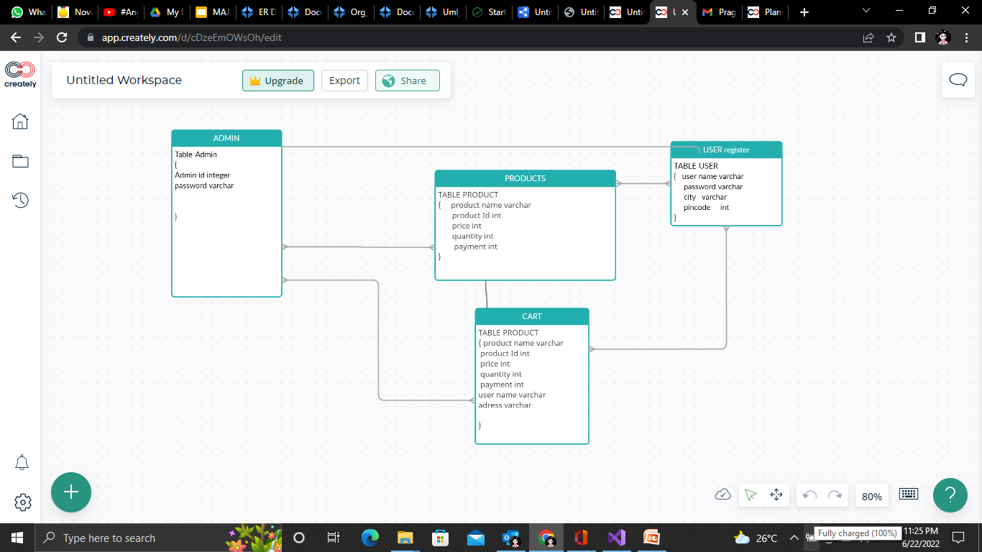
Overall Architecture Diagram

Slide 8
purpose
The purpose of this project is to digitalize the shopping.
customer can easily view and buy, which will save the time to process the request. Which will result in the faster way of the execute the shopping in execution manner and efficient handling of the requests .
THANK-YOU

